Slide 1

CSE 4000: Thesis
GENERATING SKIN LESIONS HAIR MASK PATTERNS USING GENERATIVE MODELS FOR AUTOMATED HAIR AUGMENTATION
Supervised By:
Md Abdus Salim Mollah
Assistant Professor
Department of Computer Science and Engineering
Presented By:
Jamilul huq Jami
Roll: 1807093
4th year
2nd semester

Slide 2
Introduction
Motivation
Related Works
Problem Statement
Objective
Dataset
Proposed Methodology
Implementation
Experimental result
Limitation
Conclusion
Reference
Outlines

Slide 3
01
MOTIVATION
Creating a framework that study train time hair removal is better than test time hair removal or not for skin lesions disease classification
Hair mask segmentation
Hair mask generation
Hair inpainting is required

Slide 4
01
INTRODUCTION
Generating large-sized hair masks is a critical task in computer vision, especially when they reach dimensions as large as 512x512.
Various traditional hair mask generation algorithms include Thresholding, Morphological Operations, Graph Cut Active Contours
Deep learning has revolutionized this field.

Slide 5
02
INTRODUCTION(Cont’d)
Different Deep learning approach is being used recently like
encoder-decoder, Vq-Vae
GANs, DC-Gan, W-Gan,
Style-Gan, Pro-Gan
diffusion model

Slide 6
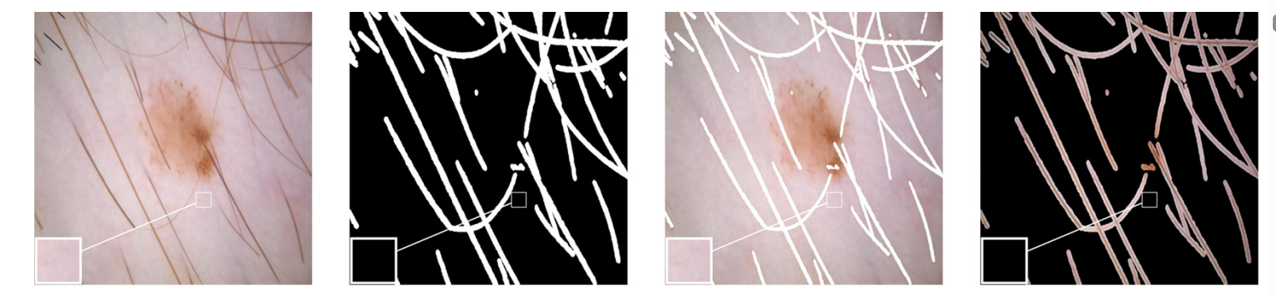
03
Related Works
Mohamed Attia et al [1] proposed a novel skin hair simulation method
Here dermoscopic image is the input
Ground truth is the hair mask getting from the dataset
A generative model conditional GAN is trained to generate the hair mask pattern
Fig1: the images show the input and generated output mask

Slide 7
04
Related Works(Cont’d)
Findings
Generative model can generate hair mask with given ground truth
It has two part one is generator and other is discriminator
It needs U-Net architecture in the generator to segment the mask from the input image
Limitations
Lack of diversity of hair pattern generation
pre segmented mask is used

Slide 8
05
Related Works(Cont’d)
The image generation method proposed by Ali Razavi et al[2] employs
Simple feed-forward encoder and decoder networks.
Additionally, VQ-VAE requires sampling an autoregressive model only in the compressed latent space.
The prior distribution is captured by a Pixel Snail model.

Slide 9
06
Related Works(Cont’d)
Findings:
Not suffering from GAN’s known shortcomings such as mode collapse and lack of diversity
Faster training and output generation than Gan model
It can be used for hair mask generation
Limitation :
It still has the shortcoming of generating high quality images like 512*512 size
Lack of stability for training and testing

Slide 10
07
Related Works(Cont’d)
image generation methos proposed by Bingqi Liu et.al consist of [4]
Enhances image generation through a deep convolutional generative adversarial network (DCGAN),
By refining the fully connected layer and using activations like LeakyReLU and Tanh, gradient disappearance is addressed .
Using the MNIST dataset, the enhanced DCGAN model exhibits a 2.02-fold improvement in image quality over traditional GAN

Slide 11
08
Related Works(Cont’d)
Limitation :
lack of diversity of the dataset (MNIST).
Issues of scalability might arise when applying the model to larger image sizes like 512*512
The effectiveness of the proposed improvements relies heavily on the choice and configuration of activation functions..

Slide 12
09
Problem Statement
Hair mask is difficult to generate because of its large size and less visibility in small size images and biased towards black pixels,
The task requires a large hair mask dataset, prompting the use of encoder-decoder networks for segmentation.
Training different generative models can indeed be time-consuming and resource-intensive .

Slide 13
10
objectives
To develop a method that can
Automated the hair mask generation process.
Can Extract hair mask from dermoscopic image.
Generate hair mask using different Generative model.

Slide 14
11
objectives(Cont’d)
To develop a method that
Compare and analysis of those models .
Evaluate the model’s outcome with different existing model.
Post process output images to get the best outcome

Slide 15
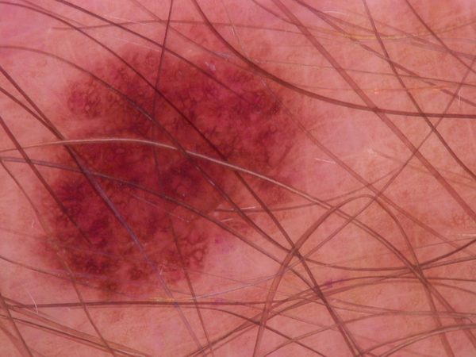
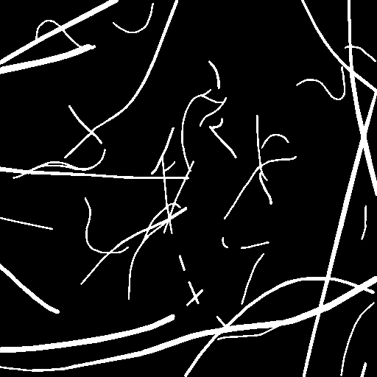
12
Dataset
To Train different generative
500 hair mask images is collected from Sk Imran Hossain et al [4].
A segmentation model is implemented using this dataset .
Ham10,000 is used to extract hair mask with the segmentation model
Fig 2. On the left a sample from HAM 10,000 and on the right hair mask from SK Imran Hossain et al

Slide 16
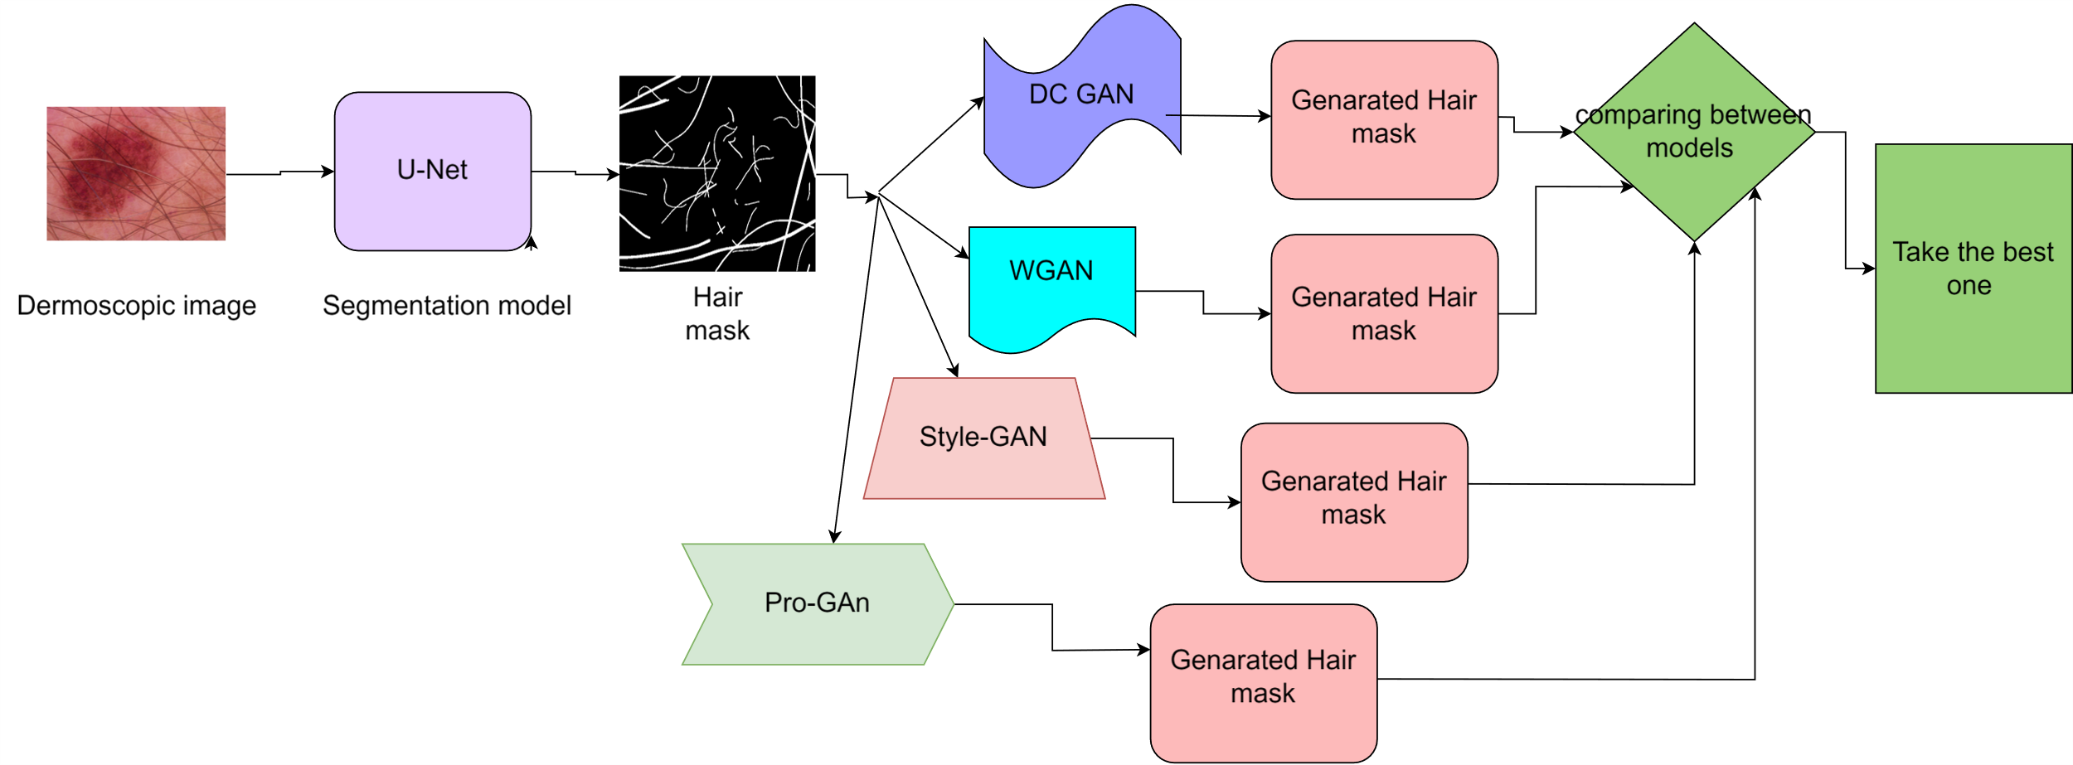
13
Proposed Methodology
Fig 3:Shows the proposed methodology of the thesis

Slide 17

14
Proposed Methodology(Cont’d)
Phase 02
Train different generative model for hair mask generation
Phase 01
Extracted hair mask from dataset using U-net
Phase 03
Post-process and Analyze the best output

Slide 18
15
Proposed Methodology(Cont’d)
Idea Selection
Literature review
Dataset collection
Methodology Study
Train different model ,postprocess and find the
best one for them
Result and analysis

Slide 19
15
Implementation
previously collected 500 dataset is used to train a U-net
This trained U-net is used to another publicly available HAM 10,000 dataset
By this 10,000 extra hair mask is generated and added to the previous dataset

Slide 20
16
Implementation(Cont’d)
Different generative model (GAN) is studied to get the proper output
DC-GAN, W-GAN ,Style GAN, Pro-GAN
Pro-GAN provided the best output

Slide 21
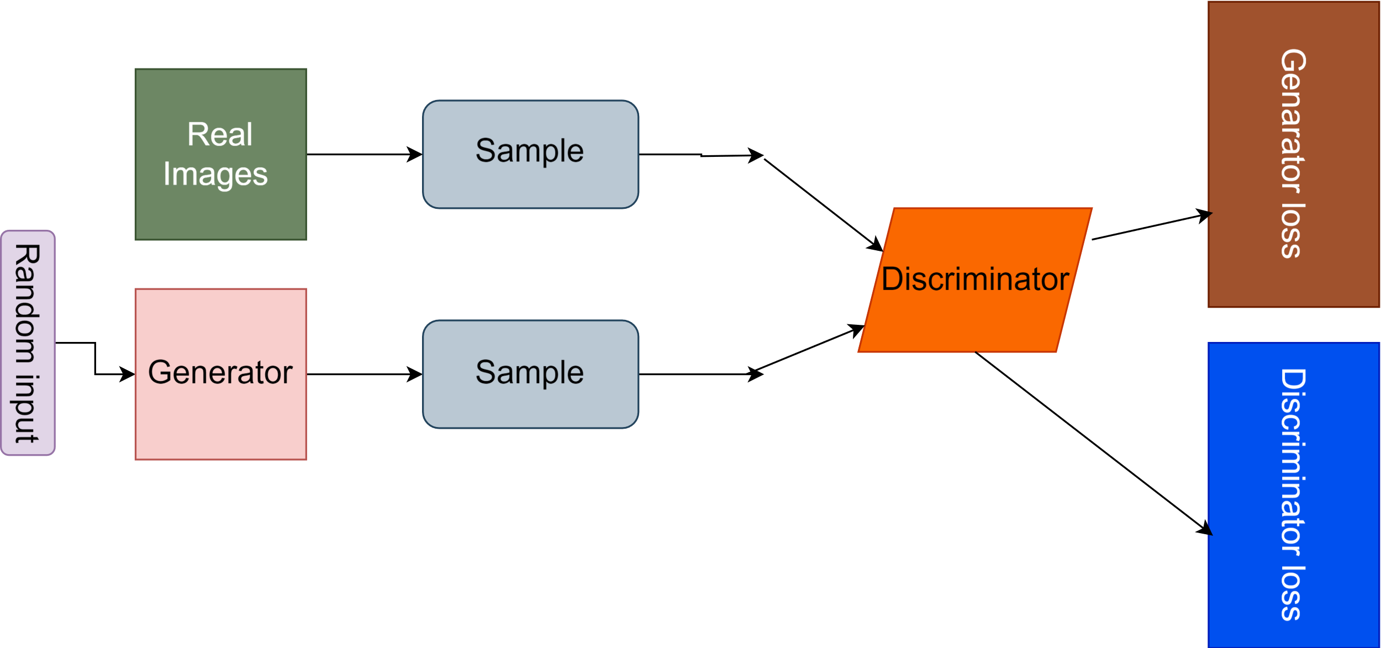
17
Implementation(Cont’d)
Fig 4: Shows the general architecture of generative model

Slide 22
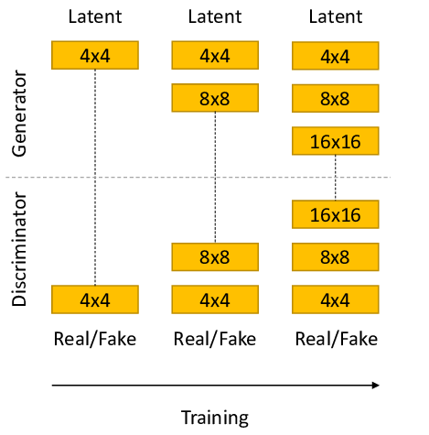
18
Implementation(Cont’d)
Pro-Gan
Progressive Training
Adding layer and increasing
the resolution of the image
Detecting the fake and real
And send it to generator
Fig 5:Pro –Gan Training structure

Slide 23
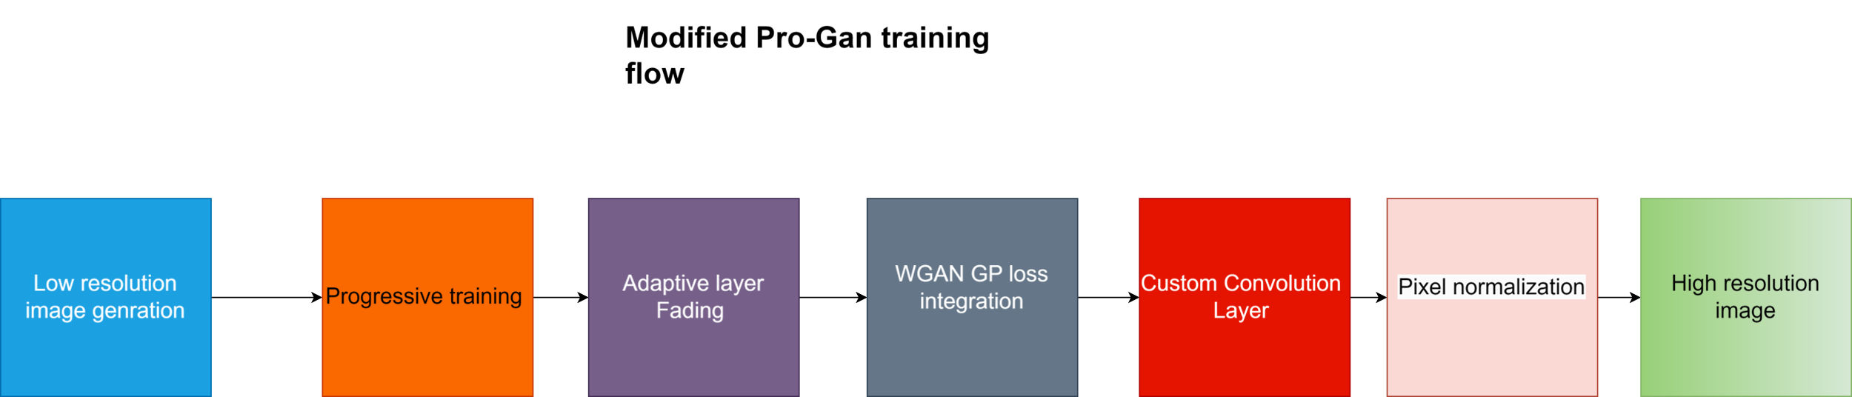
19
Implementation(Cont’d)
Modified Pro-Gan
Progressive Training
Improved image quality
Stabilized training process
Fig 6:Modified Pro-Gan training flow

Slide 24
20
Implementation(Cont’d)
Post processing of the images :
Unsharp Mask to enhance the sharpness of each image.
This method involves Gaussian blurring followed by the addition of the
difference between the original and blurred images

Slide 25
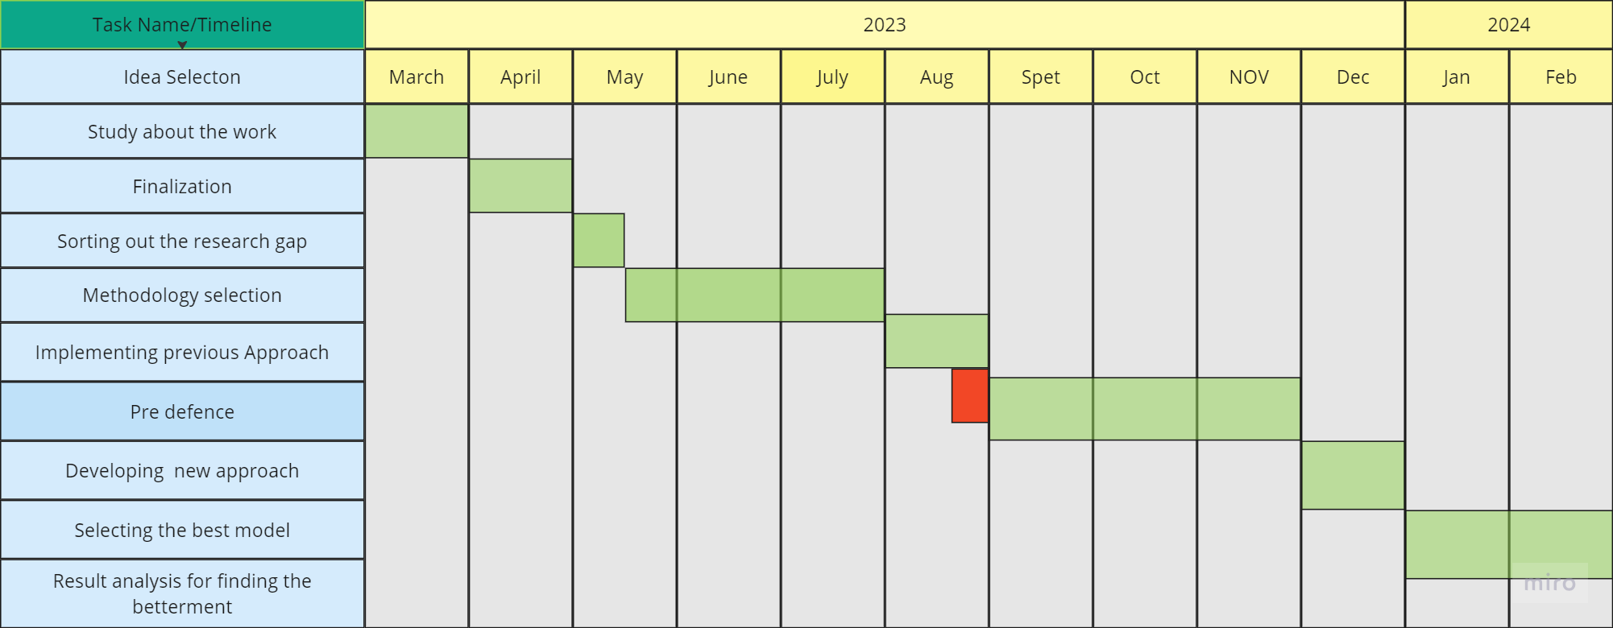
21
Work flow
Gantt chart:
Figure 5: Gantt chart of the timeline of the thesis

Slide 26
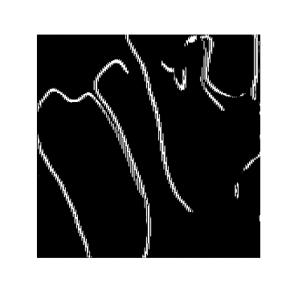
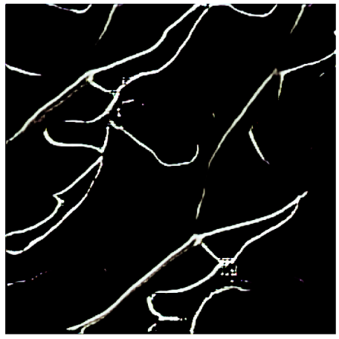
22
Experimental result
Qualitative results:
Fig 7: Output of the modified Pro-Gan

Slide 27
23
Experimental result(Cont’d)
Evaluation metrices:
PSNR (Peak Signal-to-Noise Ratio):
PSNR assesses generated image quality by comparing them to real images, quantifying noise levels relative to the maximum possible noise
SSIM (Structural Similarity Index):
Evaluates the structural similarity between two images, considering luminance, contrast, and structure.
MSE (Mean Squared Error):
MSE quantifies average squared differences between original and reconstructed image pixels, commonly assessing reconstruction accuracy

Slide 28
24
Experimental result(Cont’d)
Qualitative results:
Table 1: Comparison among different generative model

Slide 29
25
Experimental result(Cont’d)
Fig 8: Comparative analysis of different Gan model

Slide 30
26
Limitation
Limited Computational Power
Insufficiently Fine-Tuned Dataset
Biasness in Dataset
Generalization to Real-World Scenarios
.

Slide 31
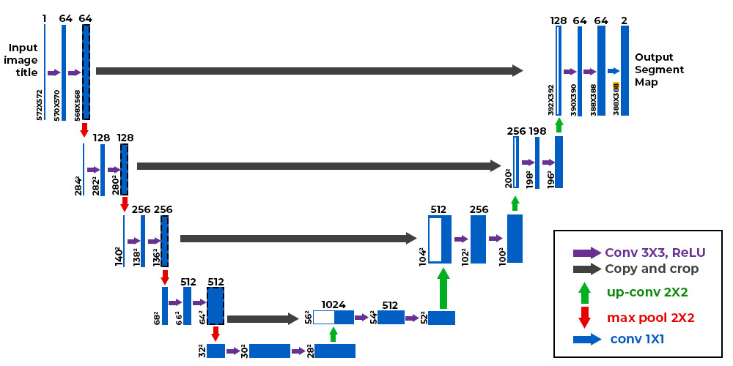
26
Proposed methodology(cont’d)
.

Slide 32
27
Future work
Generating more sharp and accurate images
Integrate to a framework
Finding some other process
Developing more accurate loss functions
.

Slide 33
28
Conclusion
Aiming to contribute to Advancement of Hair mask generation .
Aiming to contribute on large image generation techniques.
The study will be conducted using the literature as a guide which is mentioned above

Slide 34
.
01
M. Attia et al., "Realistic hair simulator for skin lesion images: A novel benchmarking tool," Artificial Intelligence in Medicine, vol. 108, p. 101933, 2020.
A. Razavi, A. Van den Oord, and O. Vinyals, "Generating diverse high-fidelity images with VQ-VAE-2," in Advances in Neural Information Processing Systems 32, 2019.
02
Reference
03
Liu, Bingqi, et al. "Application of an Improved DCGAN for Image Generation." Mobile Information Systems 2022 (2022
04
Hossain, Sk Imran, et al. "A skin lesion hair mask dataset with fine-grained annotations." Data in Brief, vol. 48, 2023, p. 109249.

Slide 35
.
05
Richardson, Elad, et al. "Encoding in style: a style Gan encoder for image-to-image translation." Proceedings of the IEEE/CVF conference on computer vision and pattern recognition. 2021.
Gao, Hongchang, Jian Pei, and Heng Huang. "Progan: Network embedding via proximity generative adversarial network." Proceedings of the 25th ACM SIGKDD International Conference on Knowledge Discovery & Data Mining. 2019..
06
Reference
07
M. Soloveitchik et al., "Conditional Fréchet Inception Distance," arXiv preprint arXiv:2103.11521, 2021

Slide 36
Thank You

